Slide 1
A network framework of cultural history
Matthew Crotty

Slide 2
A network framework of cultural history
Matthew Crotty

Slide 3

Paper Background
Title: A network framework of cultural history
Published August 2014 in the Science Journal
Authors: Maximilian Schich, Chaoming Song, Yong-Yeol Ahn, Alexander Mirsky, Mauro Martino, Albert-László Barabási, and Dirk Helbing
Published in the “Reports” section of the journal

Slide 4
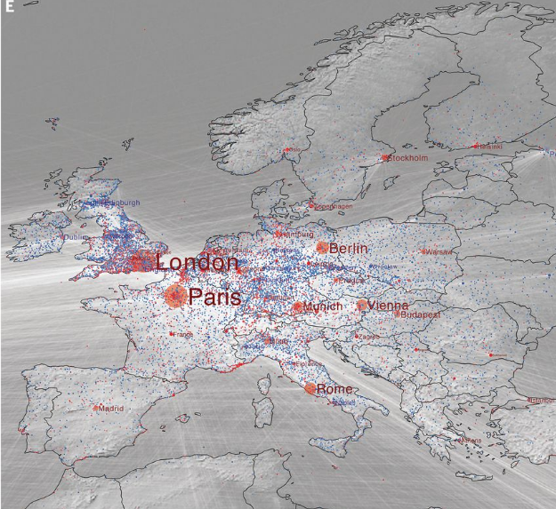
Paper Concepts
Mapping Birth and Death locations of 150,000 notable people
Shows the larger scale cultural impact of certain locations and movements
Data visualization that mirrors general population growth, wars, cultural movements, rise and fall of power throughout time

Slide 5
Data Acquisition
Data pulled from Freebase.com (no longer exists - migrated into WikiData in 2014)
  Data represented in relational format
  Pulled names, occupation, birthplace, death place and years
General Artist Lexicon
Getty Union List of Artist Names
1069 BCE - 2012 CE

Slide 6
Building the Network
Network constructed with births and deaths as weighted edges and cities as nodes
The size or importance of each node was calculated using PageRank, a popular centrality measure developed by Google
A number of calculations done on the network, including building probability distributions

Slide 7
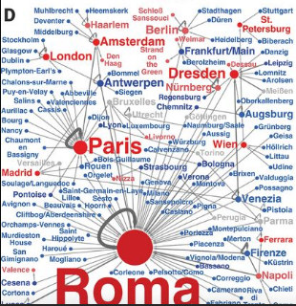
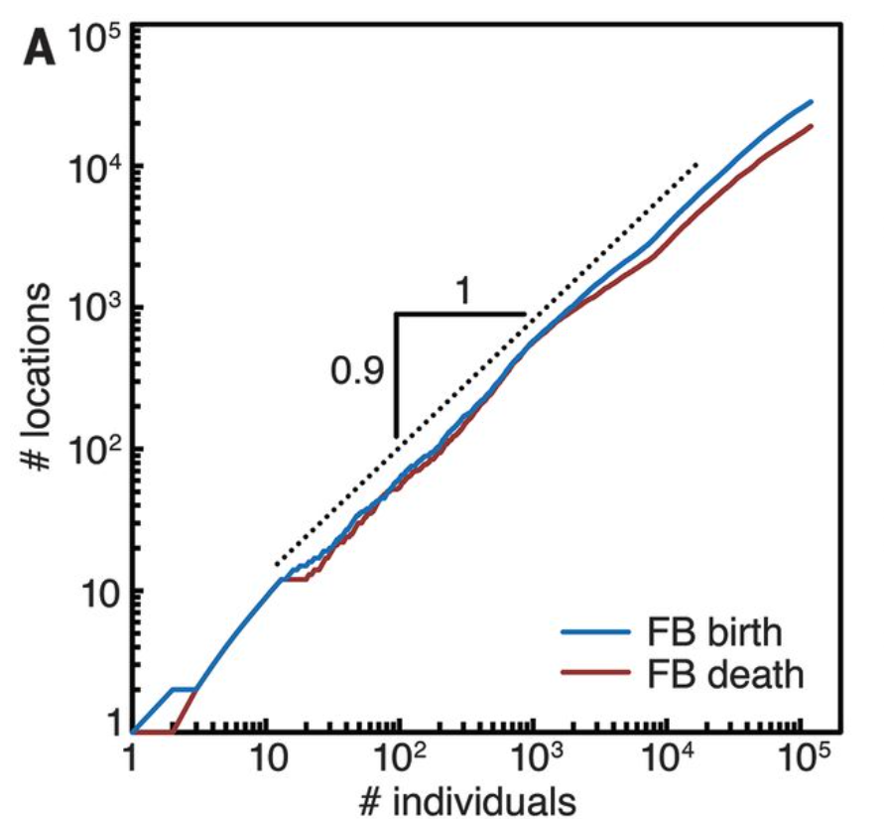
Results and Calculations
Constructing graphs like the one pictured - 18th century
Growth # Notable People / # Notable Locations - exponential growth
Metrics on mobility overtime - avg 214 -> 382
Corroborations with social science laws
Ravenstein's laws of migration
Zipf's intercity movement of persons
Heaps’ law

Slide 8
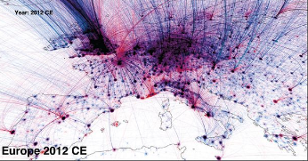
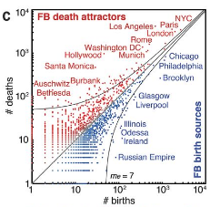
Data Visualization
Mapping the flow of births/deaths
Showing outliers and curve for cities

Slide 9
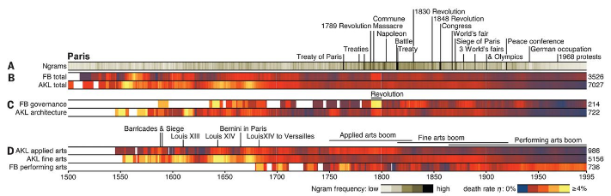
Cultural Analysis
Comparison of Birth/Death rates to Google Ngram data, which can measure literary importance of a location, in this case, Paris
Measure of “cultural centers” over time
Not the best visualization, does
not show much

Slide 10
My methods

Slide 11
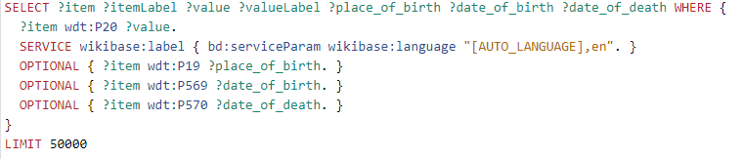
Data Acquisition
I retrieved data from wikidata.org using the SPARQL Query service, and a python library called qwikidata
To do so I constructed queries to extract relevant information from the database

Slide 12
Data Acquisition
Manual exploration of data labels and coordinates
Retrieval of location instance types and filtering
Manual selection of complete data points
Limitations of wikidata querying

Slide 13
Network Construction
networkX python package
Ended up with 3705 locations and 12898 edges, or people

Slide 14
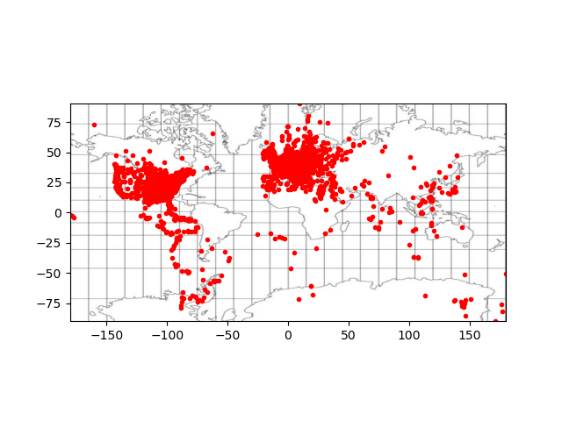
Projections

Slide 15
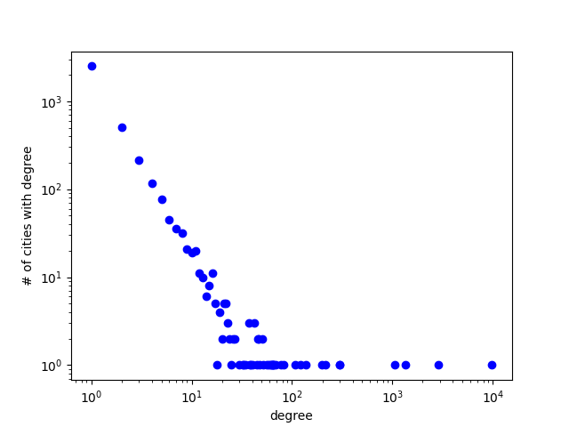
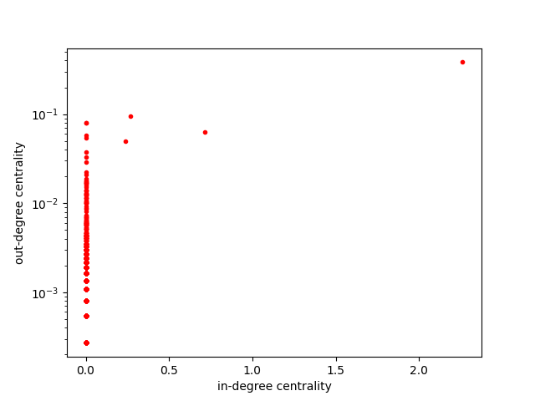
Metrics

Slide 16
Challenges
Data format very difficult to work with on a large scale
Charts and maps require skill to construct, more than I had time to learn
Method was not very well defined in paper, and seems to be difficult to replicate

